Slide 1

Motivating Use Case
BackgroundProfessional headshots are widely used on LinkedIn and CVs. Many people don't know how to take professional headshots leading people uploading low quality images or even postpone setting up the CV/Linkedin.
Why It MattersHeadshots influence first impressions in hiring and networking. Poor photos can negatively affect opportunities, especially for users without access to professional guidance.
Why It Is ChallengingProfessionalism is subjective and depends on multiple visual factors like lighting, background, framing, and sharpness. Existing tools do not quantify or explain quality.
Current SolutionsUsers rely on personal judgment, friends, or expensive photographers. Editing apps improve appearance but do not assess professionalism objectively.

Slide 2
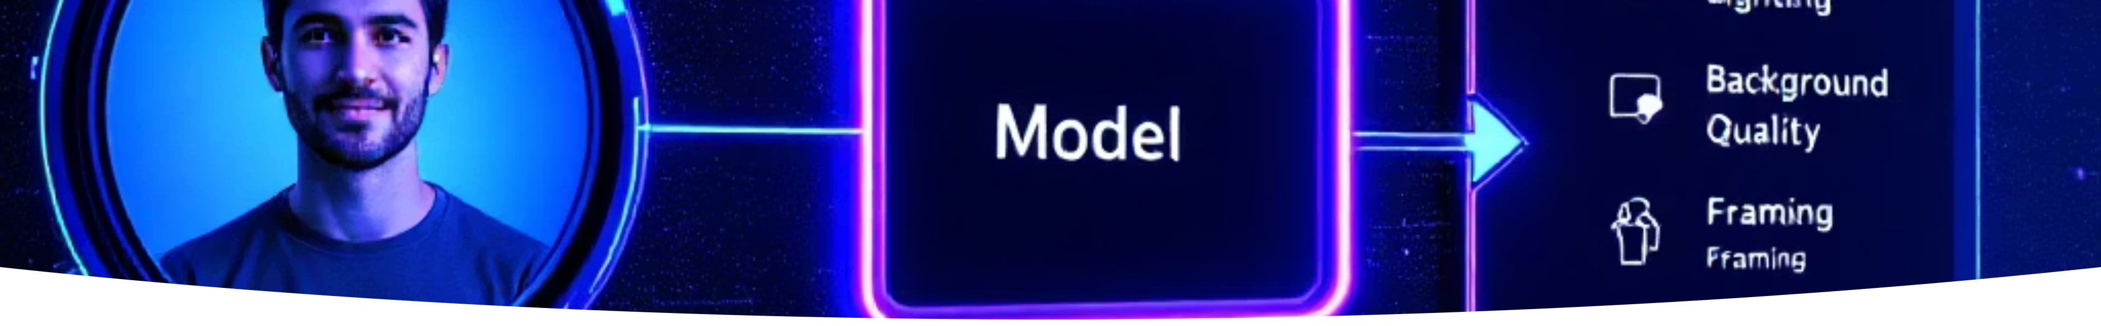
Project Task Description
Formal Problem StatementGiven an image x, predict y ∈ R⁵, a professionalism attribute vector.
Input
Output
One user provided portrait image
A professionalism 6 attribute vector consisting of
Lighting Even and Frontal
Background Clean and Non-Distracting
Business or Professional Attire Visible
Neutral Professional Facial Expression
Face Properly Framed and Centered
Image Sharpness High
NoveltyWe introduce a dedicated model for predicting headshot professionalism attributes directly from images, a task not explicitly addressed by existing vision models.

Slide 3

Models and Methods
Processing Pipeline
1
• Define a function g that maps a randomly sampled set of professionalism attributes to prompt modifications
• Apply g to base portrait images to generate synthetic headshots with known attribute degradations
• Use the applied attributes as labels
Models and Techniques
2
• Image generation: Diffusion models (WAN 2.2, FLUX, Krea 1) with prompt variations encoding professionalism attributes
• Image refinement: Super-resolution upscaling to enhance facial detail and texture
• Attribute prediction: Multi-label image classifier using a CNN or Vision Transformer (ResNet50 or ViT-B/16)
Adjustments and Fine Tuning
3
• Use a pre-trained image model to headshot images instead of training from scratch
• Fine tune the model using lightweight adaptation (e.g., LoRA).

Slide 4
Training and Evaluation Data
Training and Evaluation Data Requirements
Dataset
Labeling
Base dataset: FFHQ-like real face images Used only as unlabeled portrait inputs
No manual labeling is performed
• Unlabeled real portrait images to anchor the face distribution
Labels are assigned automatically based on the attributes injected during synthetic generation
• Multiple synthetic variations per portrait with known injected professionalism attributes
Each image receives binary labels for professionalism related attributes
• Prompt templates that explicitly encode each professionalism attribute used for labeling
Synthetic Data Generation
For each base portrait, multiple image-to-image variants are generated using a diffusion model
Prompt modifications inject specific professionalism attributes (e.g., lighting, background, framing, blur)
Generated images inherit labels corresponding to the injected attributes

Slide 5
Evaluation Metrics and Protocol
Ground Truth
Model Performance Metrics
Evaluation Protocol
Binary professionalism attribute labels defined directly by injected synthetic attributes
Split the dataset into training, validation, and test sets by base portrait to avoid leakage
• F1-score computed separately for each professionalism attribute to see how well the model detects each issue
Report performance on the held-out test set
• An overall F1-score obtained by averaging the per-attribute F1 scores equally
Synthetic Data Validation
• Verify that generated images match the intended prompt attributes
• Perform limited manual spot checks to confirm obvious label correctness

